Slide 1
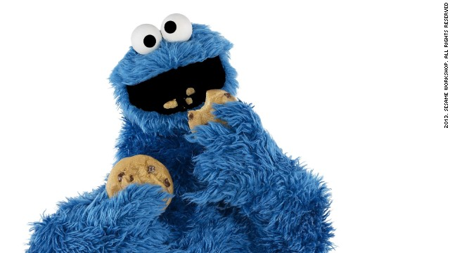
Deep Learning MSiA 490-30
Theory and Applications

Slide 2
Convectional Neural Networks
Convectional Neural Networks
Using Deep Learning to allow creative combination of ingredients and generate new recipes for people to experiment with
Group members
Lydia Chang
Stephanie Ger
Ik-Hwan Kim
Craig Ng

Slide 3
Agenda
Problem Statement
Dataset
Technical Approach
Results
Conclusion
References

Slide 4
Problem Statement
Problem Statement
Creative combination of ingredients can be difficult for most people who lack cooking experience
With help of machine learning (and a lot of data), a model can generate new recipes for them to experiment with
Difficulty
Current machine learning models are effective at copying and regurgitating inputs
Generating original output from those inputs can be bit more problematic
Other approaches
Models have been trained on a very general set of recipes including multiple types of food
Some common ingredients like salt appears in recipes as varied as cakes, burgers and pizzas, confusing the model
Models trained with both directions and ingredients adds to the complexity and the models focused on learning format rather than content

Slide 5
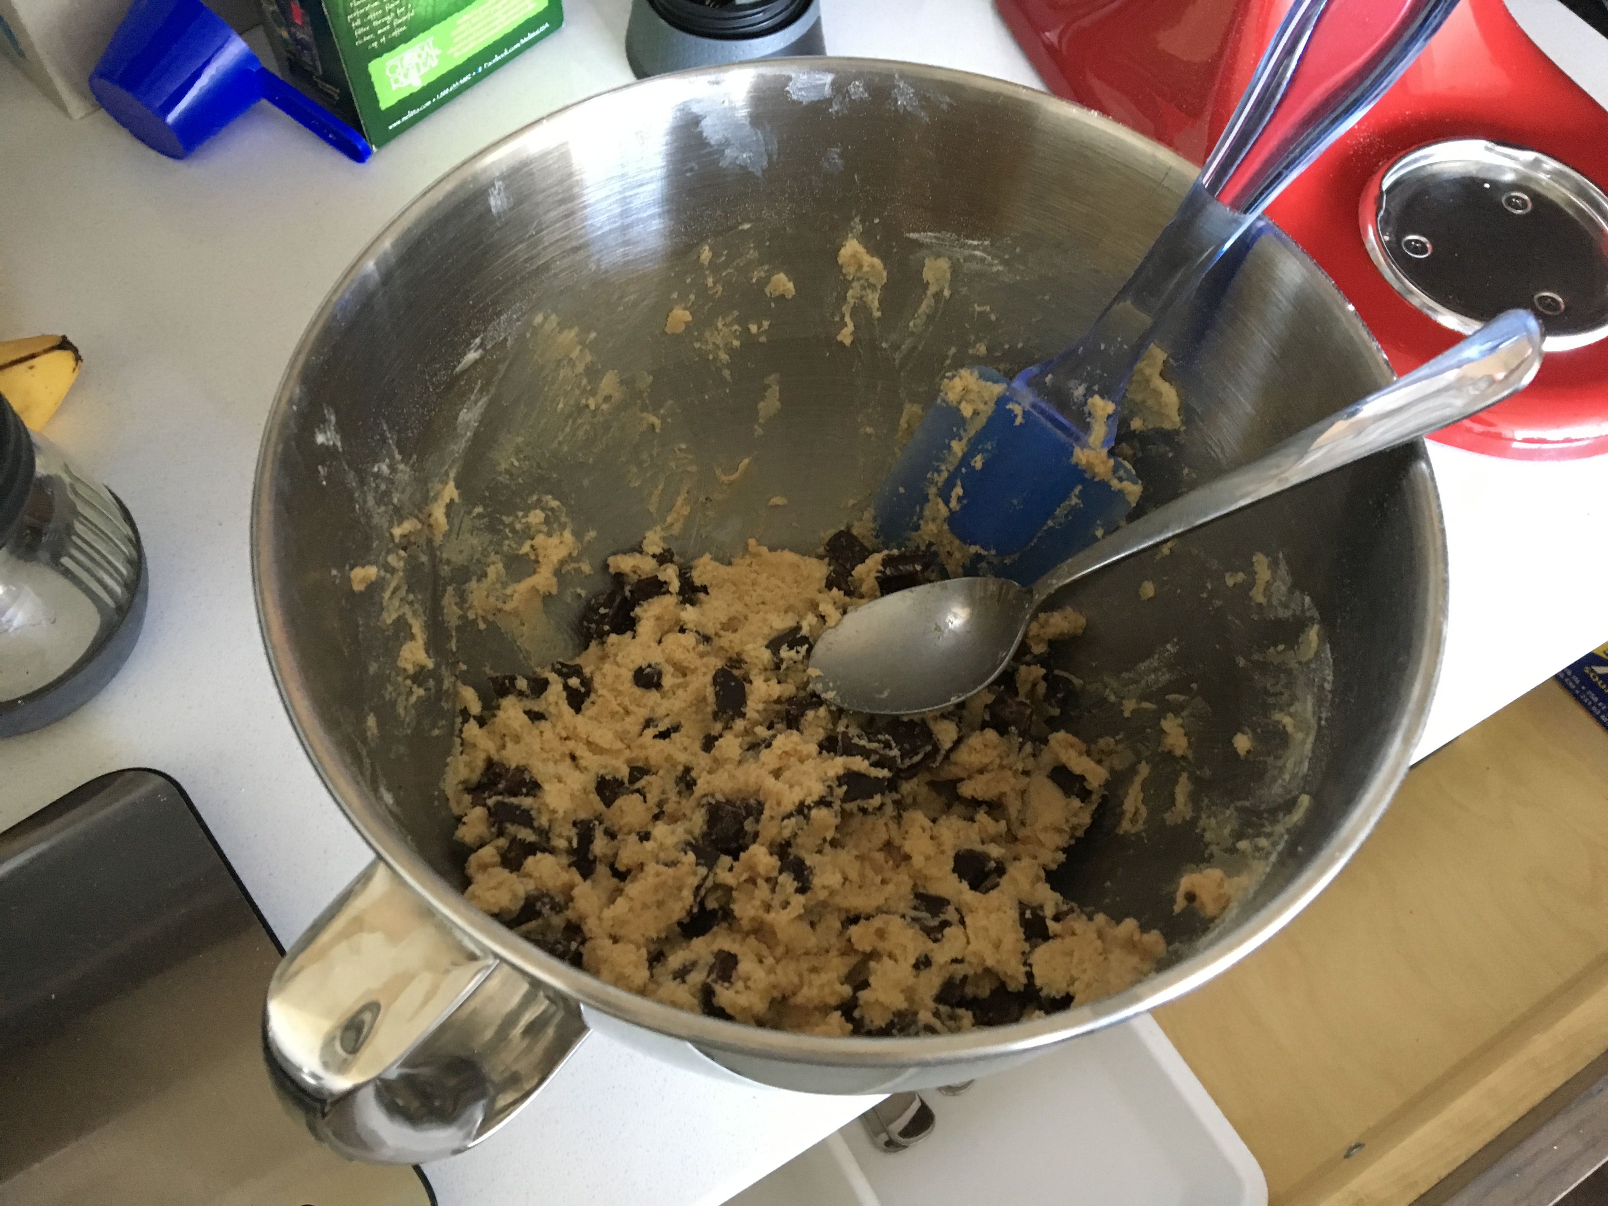
Dataset
Scraped 80,000 ingredient lists from Yummly using the search parameter ‘cookie’
Example Raw Data: ['2 cups flour', '1 teaspoon baking powder', '1 teaspoon baking soda', '1 teaspoon salt', '3/4 cup butter, room temperature', '3/4 cup brown sugar (packed)', '3/4 cup granulated sugar', '2 large eggs', u'2 teaspoons vanilla (or slightly more, to taste)', '3 1/2 cups old-fashioned oatmeal', '2 cups raisins (soaked in hot water flavored with vanilla, then drained)']
Cleaning the Data:
Removed any recipes that didn’t have cookie in the title
Removed special characters
Inspected the final dictionary and removed any words that were instructions or were unrelated to cookies
Local machines were sufficient to process the data, but training the models (especially the character-level embeddings) required the GPU cluster
Since the recipes generated from various seeds did not repeat or closely mimic the original recipe, we believe that the models did not overfit

Slide 6
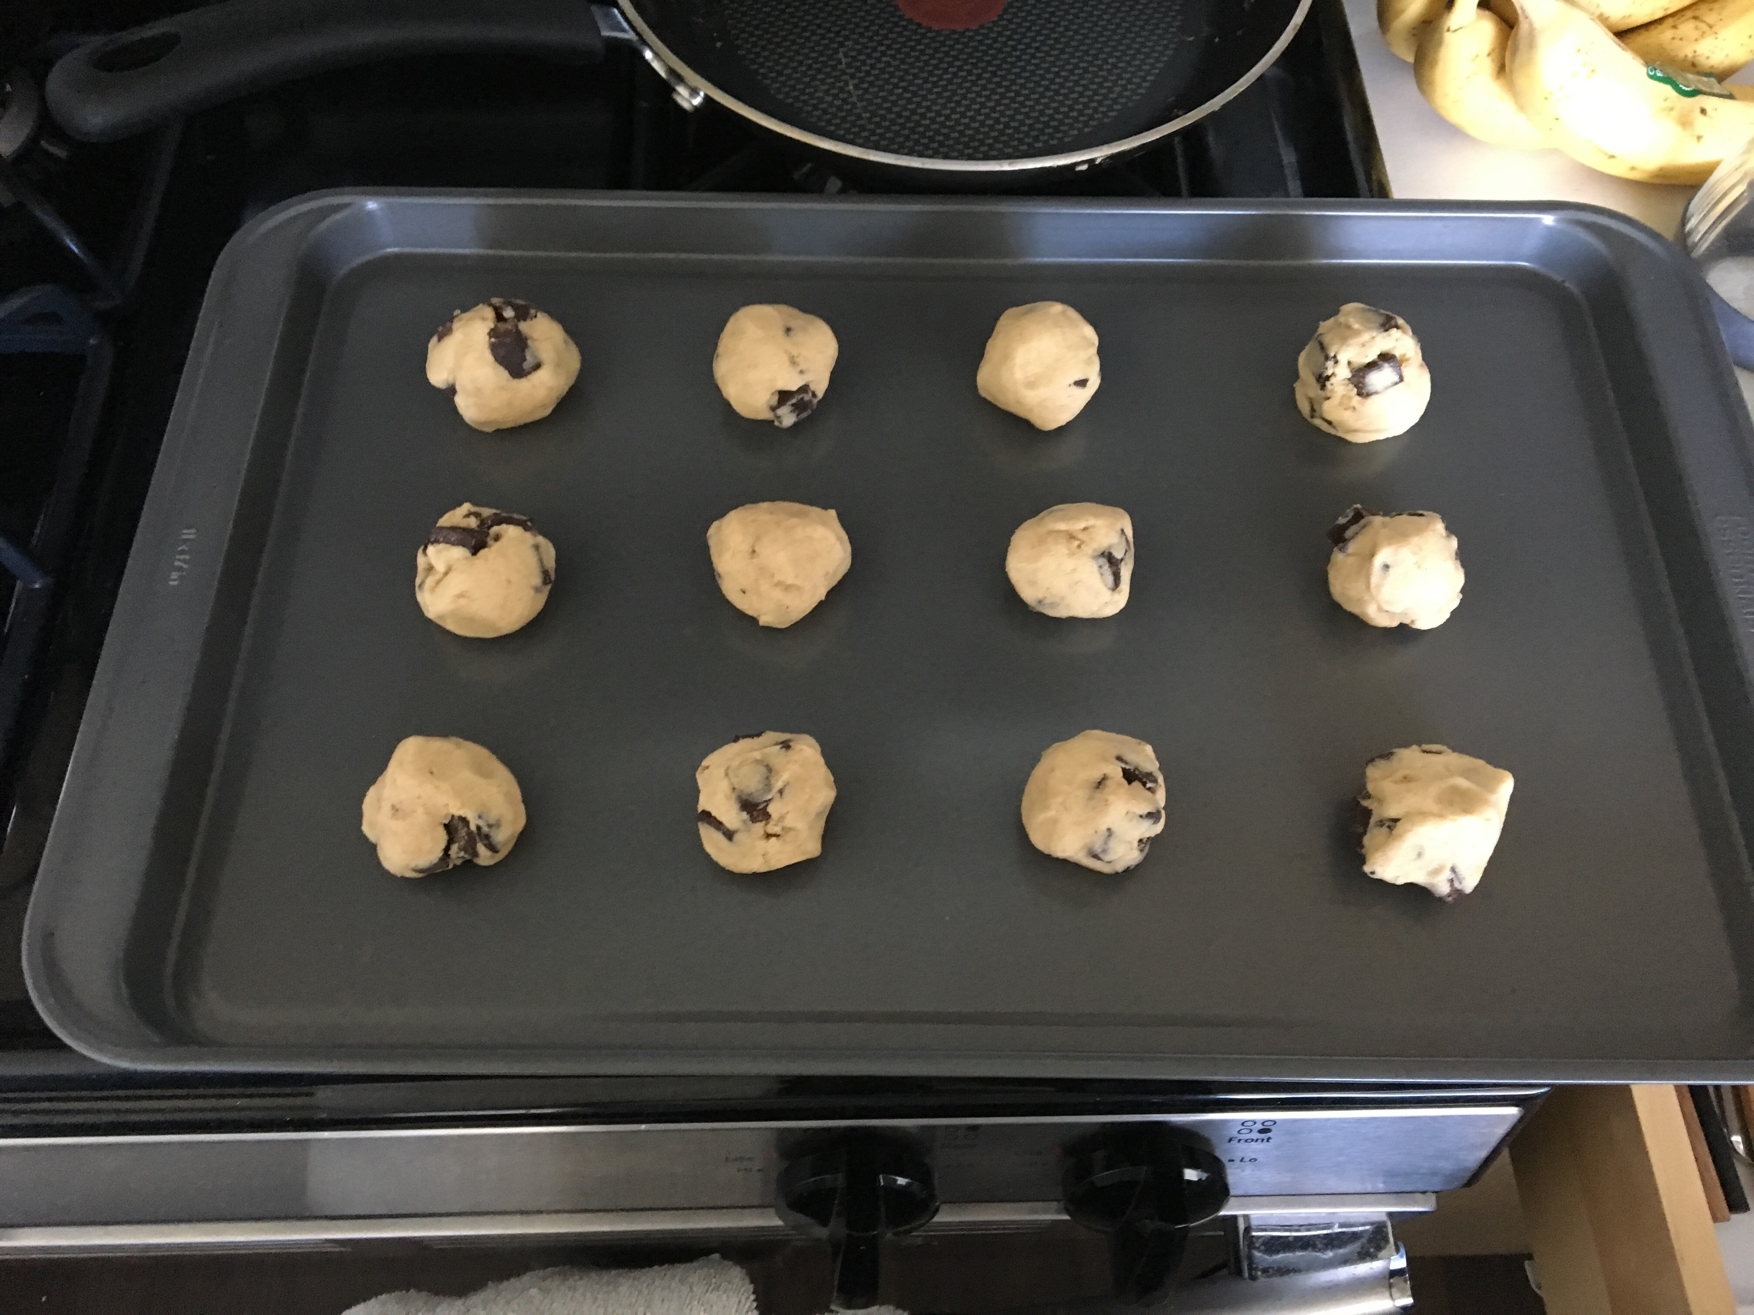
Technical Approach 1
Step 1: Preprocess the data
Prepended the title of the recipe to the beginning of the recipe
Created synthetic data by shuffling the ingredient list for each recipe to combat order dependency
Step 2: Consider Embedding
Use phrase2vec with different embeddings: character-level, word-level, phrase-level
For character-level, used a sentence of length 40 and a moving frame
For word- and phrase-level, used a sentence of length 50
Step 3: Model Evaluation
Ran the code with each levels of the embedding for at least 60 epochs
Evaluated model success by looking at the novel recipes generated by the model
Step 4: Hyper-parameter Tuning
Compared GRU, LSTM, adjusted number of layers (2 or 3), adjusted hidden neurons (128, 256, 512), and considered a character-level CNN model
Step 5: Generate Recipes
Use keyword search to randomly select recipe, then use first 40 characters to generate recipe

Slide 7
Technical Approach 2
Recurrent Neural Network (RNN): connections between units form a direct cycle so that it can exhibit dynamic temporal behavior
Long short-term memory (LSTM): improves upon RNNs using memory cells that remember long-term values
Gated recurrent units’ (GRUs): performance is similar to LSTM, but lack an output gate Figure 1 Illustration of RNN Figure 2 LSTM vs GRU

Slide 8
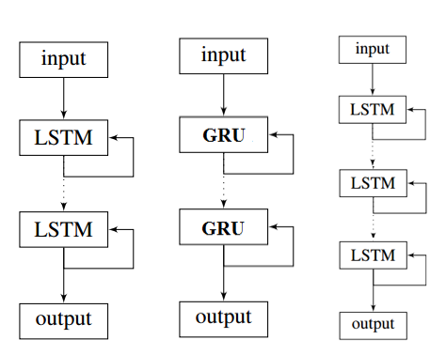
Technical Approach 3
Alternative Approach
Bidirectional RNNs: connect two hidden layers of opposite directions, so the output layer can get information from both past and future states
Convolutional NNs: use layers with different numbers of hidden neurons to capture a range of time dependent features
Figure 3 The structures of our models

Slide 9
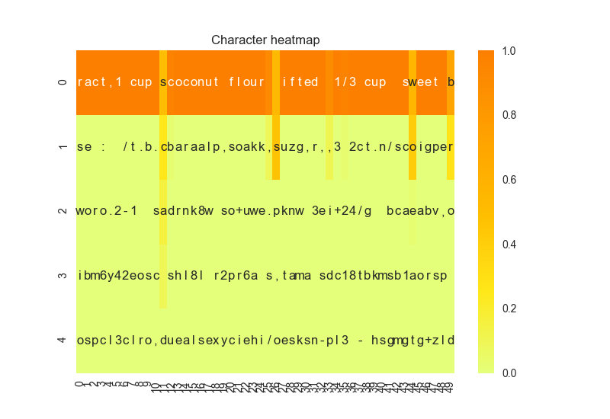
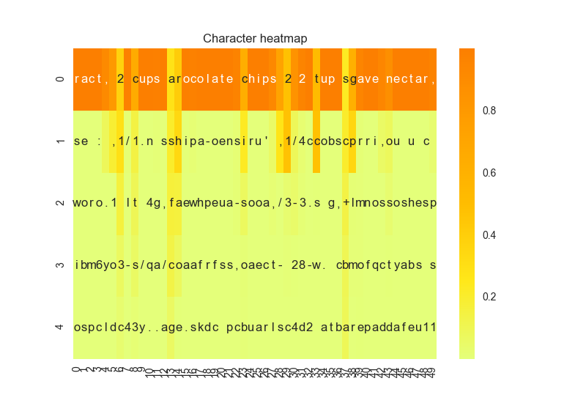
Results 1
Character level embedding with CNN
Heat map with diversity = 0.2
Heat map with diversity = 1.2

Slide 10
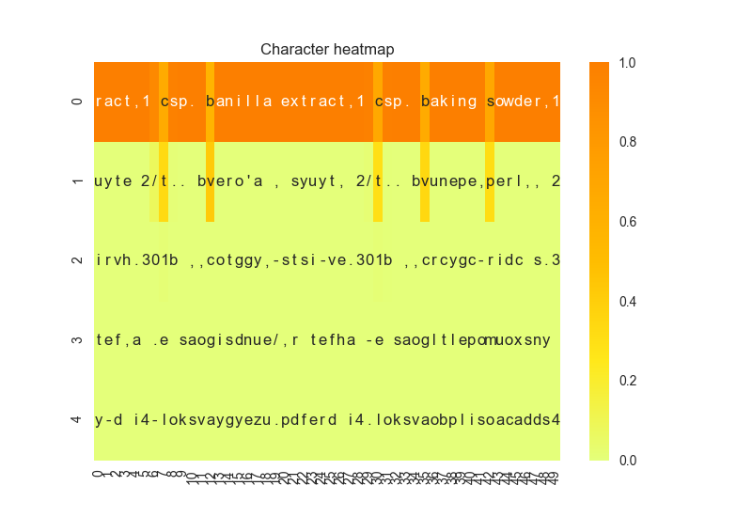
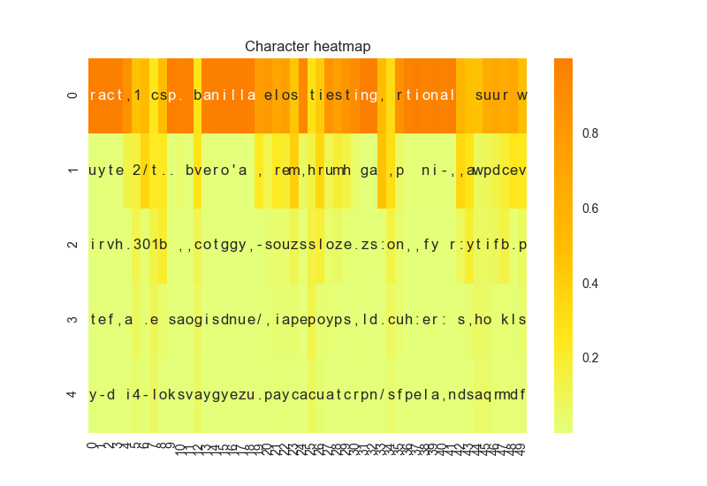
Results 2
Character level embedding with LSTM
Heat map with diversity = 0.2
Heat map with diversity = 1.2

Slide 11
Results 3
Example output
Character-level: 1/2 tsp. baking soda,1 tsp. vanilla extract,1 cup all purpose flour,1 teaspoon baking soda,1 teaspoon salt,6 tablespoons brown sugar,2 cups candy covered plus 1/4 finely diced,1/2 cup firmly packed brown sugar,1 egg 1 3/4 cups sugar,2 la 1/2 tsp. baking soda,1 tsp. vanilla extract 2 cups chocolate chips,1/2 cup agave nectar,1 teaspoon coconut extract ,1 teaspoon salt,1 cup nutella, 1/2 cup rainbow sprinkles of chopped nuts,1/3 cup chocolate hot cocoa powder,1 tsp vanilla
Word-level: Chocolate Biscuit syrup light cold of syrup 3 tablespoons soft oil 2 cups water 3/4 cup sugar 1/2 cup butter softened 2 tablespoons milk 1 teaspoon baking powder 1/2 teaspoon salt
Phrase-level: 1/2 cup soy or coconut vanilla flavored creamer 2 teaspoons of vanilla extract 2 teaspoons vanilla essence 1 flax egg 2 tablespoons egg or whey chocolate protein powder 2 large egg yolks at room temperature 1/3 cup dark chocolate chips 1 cup semi sweet chocolate chips 3/4 cups granulated sugar

Slide 12
Results 4
Why can we trust your model?
By the scope of our project, the output requires human validation because it does not include directions on how to bake the recipe
The generated output does not closely mimic the seed recipe, so it is not overfitting
Heatmaps provide insight into what the model is ‘thinking’
What are the strengths of the model?
Does well predicting around numbers
Once it selects the first letter, it becomes more sure
Where does the model fall short?
Struggles to pick the next word (least sure on the first letter of a new word)

Slide 13
Conclusion
Brief summary of what you discovered based on results
All three embeddings capable of producing reasonable recipes
Phrase-level embedding produced the most ”legible” recipes, but was also the least creative and vice-versa for character-level embedding
Difficult to determine the differences in model performance from hyper-parameter tuning because the output evaluation is subjective
Limitations of approach
Dictionary limited to those words/recipes available via Yummly
How to improve/future work
Use prepended titles as part of training observations to give models the ability to generate recipes using created titles (e.g., [Oatmeal Chocolate Chip Cookie])
Generalize to include other recipe types, then generate hybrid recipes (e.g., [chocolate chip cookie muffin])

Slide 14
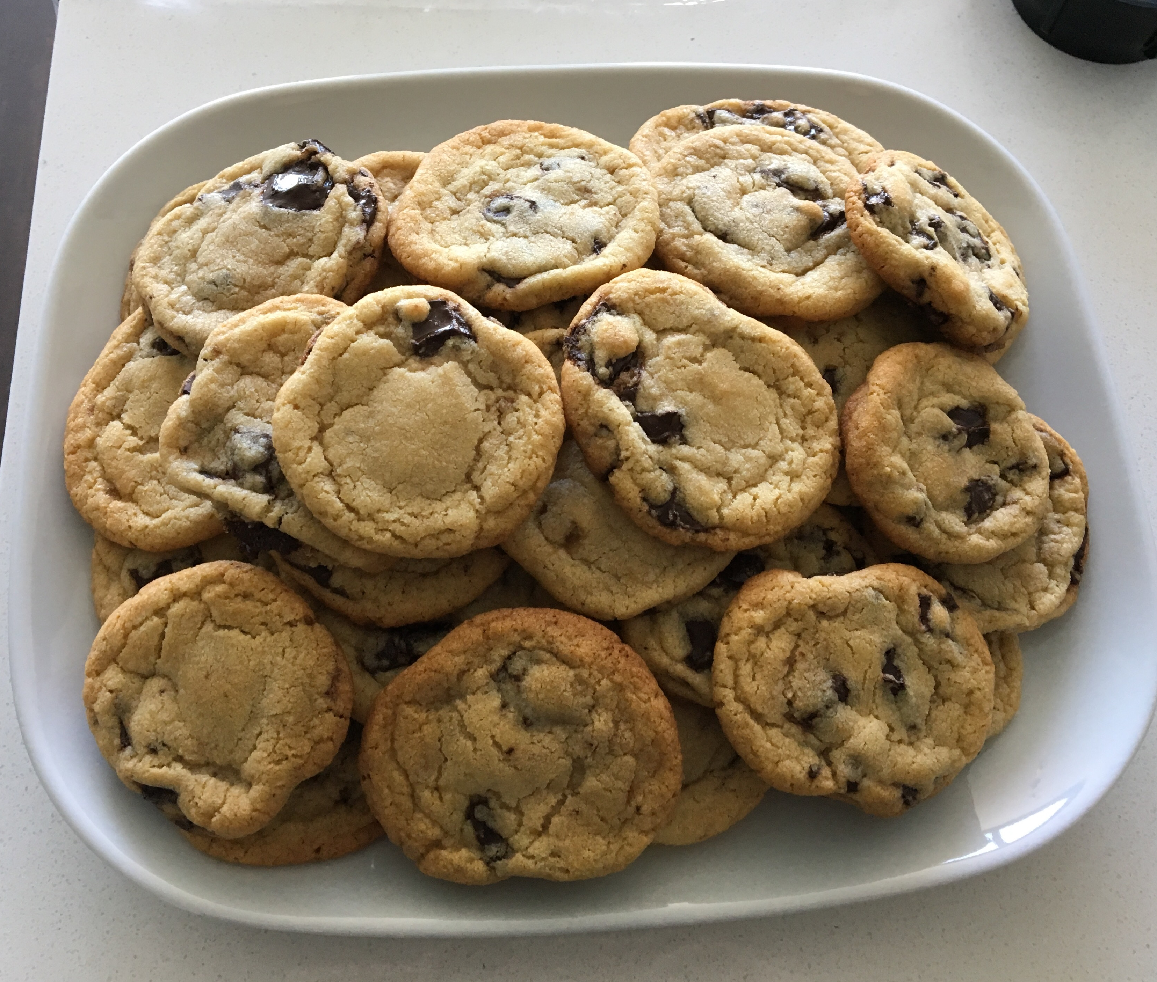
Enjoy!

Slide 15
References
Do Androids Dream of Cooking? (Tom Brewe)
https://gist.github.com/nylki/1efbaa36635956d35bcc
Keras LSTM Text Generation Example Code (François Chollet)
https://github.com/fchollet/keras/blob/master/examples/lstm_text_generation.py
Word RNN Tensorflow Code (Sung Kim)
https://github.com/hunkim/word-rnn-tensorflow
The Unreasonable Effectiveness of Recurrent Neural Networks (Andrej Karpathy)
http://karpathy.github.io/2015/05/21/rnn-effectiveness/
Generating Text with Recurrent Neural Networks (Ilya Sutskever, James Martens, Geoffrey Hinton)
https://pdfs.semanticscholar.org/93c2/0e38c85b69fc2d2eb314b3c1217913f7db11.pdf

